Slide 1
Lesson 11 Integration of Algebraic Functions Interactive Seminar
E114 – Mathematics for Engineering

Slide 2
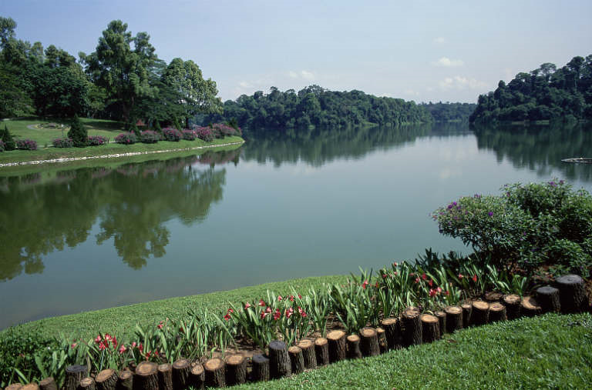
Scenario - Water not enough
A public agency that manages a local reservoir is making a study on water resources. As they noticed that the water level was gradually decreasing, one part of the study is to determine when the water from the reservoir would run out.

Slide 3
Scenario - Water not enough
The reservoir currently has 6 million m³ of water.
It is known that the reservoir is being supplied at an average rate of 8,212,560 m³ per month.
Based on past research, the agency projected that the rate of water consumption per month is
where t is the time in months.
As a part of the agency, your team is tasked to evaluate the situation by finding out when the reservoir would be empty.

Slide 4
Scenario - Water not enough
Consider the following questions:
What is the rate of water supply and rate of water consumption per month?
What is the net rate of change function for the water volume?
What is the quantity function for the water volume?
How would determining the quantity function of the water volume in the reservoir help you to find out when the reservoir would be empty?

Slide 5
Scenario Definition Template
What do we know?
The rate of water supply and rate of water consumption per month
The quantity (volume of water in the reservoir) at the beginning
(from pre-readings) We can perform integration on the net rate of water supply to find the quantity (volume of water remaining in the reservoir) at any given time
What do we not know?
How can we perform integration on an algebraic function?
What do we need to find out?
When (in number of months) would the reservoir run out of water?

Slide 6
Lesson Overview
S/N | Concepts | Slide Number
1 | Relationship between differentiation & integration | 7-8
2 | Integrating an algebraic expression | 9-17
3 | Finding the constant c | 18-21
4 | Integration of a definite integral | 23-27
5 | Applications of integration (CL) | 28-39

Slide 7
Differentiation and Integration
The relationship between differentiation and integration is shown below.
Differentiate
f (x)
f’ (x)
Integrate

Slide 8
Differentiation and Integration
If the differentiation of the function f (x) with respect to x is given by
Then the integration of the function f’(x) with respect to x is given by
The function f(x) is called an anti-derivative or integral of the function f’(x).

Slide 9
Differentiation of an Algebraic Expression
Recall the basic rule of differentiation:
Therefore,
1. “n” is brought down and multiplied by the coefficient of x
2. x^{n} becomes x^{n-1}
Note: k is a constant
Note: n = 0 when the function f(x) is a constant, n ≠ -1

Slide 10
Integrating an Algebraic Expression
Recall the relationship between differentiation and integration:
Since ,
Therefore,
1. x^{n} becomes x^{n+1}
2. “n+1” then becomes the divisor of x^{n+1}
Note: n ≠ -1

Slide 11
Integrating an Algebraic Expression
Consider the two differentiations below:
From this, we see that the anti-derivative of 4x will give infinite number of answers. So in general, we will add a constant c to represent all the possible answers:

Slide 12
Integrating an Algebraic Expression
To summarise, the integration of an algebraic expression is
where c is a constant and n ≠ -1
This is called an integration of indefinite integral as it represents a family of anti-derivatives.
1. x^{n} becomes x^{n+1}
2. “n+1” then becomes the divisor of x^{n+1}
3. Add “c” to take care of multiple possible solutions

Slide 13
Integrating an Algebraic Expression
Linearity rules of integration:
A constant factor in an integral can be moved outside the integral sign in the following way:
where c is a constant and n ≠ -1
To integrate the sum or difference of two functions, each term can be performed separately as follows:

Slide 14
Integrating an Algebraic Expression
[Example]
Find the indefinite integral of
[Solution]
From linearity rule,
From formula,
1. x^{n} becomes x^{n+1}
2. “n+1” then becomes the divisor of x^{n+1}
3. Add “c” to take care of multiple possible solutions

Slide 15

Test Yourself: Integrating an Algebraic Expression
Find the indefinite integral for the following questions:
(a)
(b)
(c)

Slide 16
Test Yourself: Integrating an Algebraic Expression

Slide 17
Test Yourself: Integrating an Algebraic Expression

Slide 18
Test Yourself: Integrating an Algebraic Expression

Slide 19
Finding the constant c
After integration, the constant c can be found by substituting in a given condition.
[Example]
[Solution]
Given that y = 4.2 when x = 2,
Substituting into the expression,
Hence ,

Slide 20
Test Yourself: Finding the constant c
Find the expression for y in the following given conditions:

Slide 21
Test Yourself: Finding the constant c

Slide 22
BRAIN BREAK
“It does not matter how slowly you go as long as you do not stop.”
- Confucius

Slide 23
Integration of Definite Integral
For integration of indefinite integral,
For integration of definite integral, the integral is bounded by lower and upper limits a and b. The expression is given by

Slide 24
Integration of Definite Integral
[Example]
Find the indefinite integral of
[Solution]
Is this correct?
Need to do integration first!

Slide 25
Integration of Definite Integral
[Example]
Find the indefinite integral of
[Solution]
1. Integrate f’(x) to get f(x)
2. Substitute the values
b and a into f(b) - f(a)
25

Slide 26
Integration of Definite Integral (Kahoot.IT)
Notes:
https://play.kahoot.it/#/k/25603287-2d95-47a4-b886-180936d830ac

Slide 27
Test Yourself: Integration of Definite Integral
Evaluate the following definite integral:

Slide 28
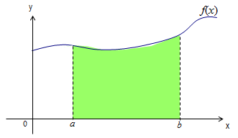
Applications of Integration
Rate of change function
f '(t)
Integrate
Quantity function
f (t) = ∫ f '(t) dt
Velocity function
v(t)
Integrate
Displacement function
s(t) = ∫ v(t) dt
Equation of graph
f (x)
Integrate
Area under graph
A(x) = ∫ f (x) dx
Note: The area under graph would be positive when f(x) and a are positive and b > a

Slide 29

Applications of Integration
[Example]
Suppose an empty water tank is filled with water at the rate f(t) = 2t³ – 5t ² + 6 cm³/s from time t = 0s to t = 3s. Find the total amount of water the tank would have been filled with from time t = 0s to t = 3s.

Slide 30
Applications of Integration
[Solution]
Hence, the total amount of water the tank would have been filled with from time t = 0s to t = 3s would be 13.5 cm³

Slide 31

Applications of Integration
[Example]
Sam is walking at a velocity of v(t) = 3t + 5. It is known that his initial displacement at t = 0 is 2m. Find the displacement function s(t) of Sam.
Given t = 0, s(t) = 2,
Hence,
[Solution]

Slide 32
Test Yourself: Applications of Integration
A ball is thrown to the ground from the top of a building. The speed of the ball in m/s is given by:
v(t) = 10t + v_{o}
where t is the number of seconds after the ball is thrown & v_{o} is the initial speed of the ball.
If the ball travels 25m during the first 2 seconds after it is thrown, what is the initial speed of the ball?

Slide 33
Test Yourself: Applications of Integration

Slide 34

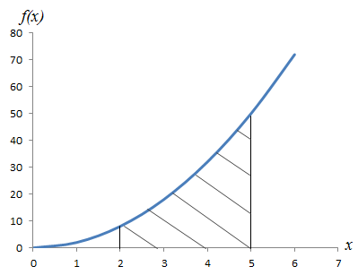
Applications of Integration (CL)
[Example]
The equation of a curve shown below is given as f (x) = 2x². Find the area of the shaded region.
[Solution]
Note : The function f(x) can be used in many different scenarios. E.g. if f(x) represents the acceleration function of a particular object, then the shaded region would represent its change in velocity from time = 2s to 5s.

Slide 35
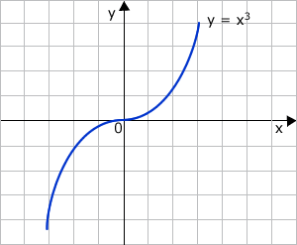
Applications of Integration (CL)
[Example]
The equation of a curve below is y = x³. Find the area bounded by the curve and the lines x=-3 and x=3.
A2
-3
A1
3

Slide 36

Applications of Integration (CL)
[Solution]
Find area of A1 first
Area of A1 = |- $\frac{81}{4}|$ = $\frac{81}{4}$
A2
-3
A1
3
(Since area cannot be a negative value)

Slide 37

Applications of Integration (CL)
Next find area of A2
A2
-3
A1
3
The total area = $\frac{81}{4}$ + $\frac{81}{4}$
= $40\frac{1}{2}$

Slide 38
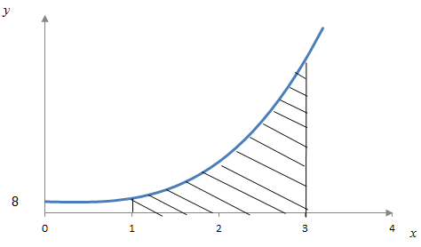
Poll: Applications of Integration (CL)
Find the area bounded by the curve , the x-axis and the lines x = 1 and x = 3.
Which of the following option is the correct answer?
2

Slide 39
Poll: Applications of Integration (CL)

Slide 40
One-minute write
Instruction for lecturers: please copy the correct link and put it in the yellow box in the next slide for your IS class:
https://todaysmeet.com/LRE2-Day3
https://todaysmeet.com/LRE4-Day3
https://todaysmeet.com/LRW3-Day3
https://todaysmeet.com/LRW5-Day3
https://todaysmeet.com/LRE5-Day3
https://todaysmeet.com/LRE2-Day4
https://todaysmeet.com/LRE4-Day4
https://todaysmeet.com/LRW3-Day4
https://todaysmeet.com/LRW5-Day4
https://todaysmeet.com/LRE5-Day4
https://todaysmeet.com/LRE2-Day1
https://todaysmeet.com/LRE4-Day1
https://todaysmeet.com/LRW3-Day1
https://todaysmeet.com/LRW5-Day1
https://todaysmeet.com/LRE2-Day2
https://todaysmeet.com/LRE4-Day2
https://todaysmeet.com/LRW5-Day2
https://todaysmeet.com/LRW3-Day2

Slide 41
One-minute write
Instruction for lecturers: please copy the correct link and put it in the yellow box in the next slide for your IS class:
https://todaysmeet.com/LRE2-Day5
https://todaysmeet.com/LRE4-Day5
https://todaysmeet.com/LRW3-Day5
https://todaysmeet.com/LRW5-Day5

Slide 42
One-minute write
Please stop what you are doing and produce a written response to either of the following in only one minute:
Identify what is the key learning concepts from the seminar, or
Write down a question with respect to the concepts learnt so far.
Link:

Slide 43
Learning Objectives
Recognise integration as a possible way to find quantity accumulated given the rate of change function
Apply integration on algebraic functions
Model and analyse real world problems using integration of algebraic functions

